Slide 1
Introduction to communication systems
Sdr stem camp
Developed by: Spencer grady & hunter litke

Slide 2
Communication system basics
A communication system conveys information from its source to a destination
Examples include
Telephone
TV
Radio
Satellite
Notes:
-

Slide 3
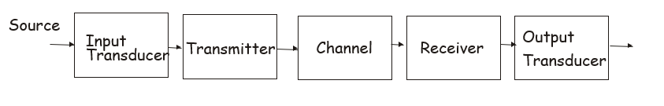
Communication System basics
A communication system has the following components at its simplest form
Notes:
- Instructor should walk through each component and give a brief description of what each one does. There are slides following this one that instructors can use to reference

Slide 4
Input Transducer
The input transducer converts the original message that is produced by a source to a signal in an acceptable form for the communication system.
Example:
Voice MICROPHONE Voltage
Notes:
A perfect example of an input transducer is a microphone.
A microphone converts the users voice, which are sound waves, into an appropriate signal form for transportation.

Slide 5
Transmitter
A transmitter couples the message to the channel and is responsible for sending the data. They also modulate and/or amplify the signal to send the message.
Example:
TV and Radio stations broadcasting their content

Slide 6
Channel
A channel is the physical medium that the message is transmitted over.
No channel is perfect, so signals become distorted, pick-up noise, or interference.
Example:
Air, wires, EM waves

Slide 7
Receiver
The receiver receives/extracts the message/signal.
The receiver can amplify and/or demodulate the signal.
Example:
TV, radio

Slide 8
Output Transducer
The output transducer converts the signal the proper form for the system.
Example:
Loudspeakers

Slide 9
Limitations
Bandwidth is one of the key limitation of communication systems.
Bandwidth: Bandwidth is the range of frequencies related to a system.
Examples of system with different bandwidths:
AM Radio, FM Radio, TV, cellular networks, satellite, air traffic control

Slide 10
Limitations
Noise is the other key limitation of a communication system. There is internal and external noise.
Think of noise in communication systems the same way you would if you were trying to hear what someone is saying at a loud stadium.
Internal Noise is generated by components within the system.
External noise is generated by components outside of the system.

Slide 11

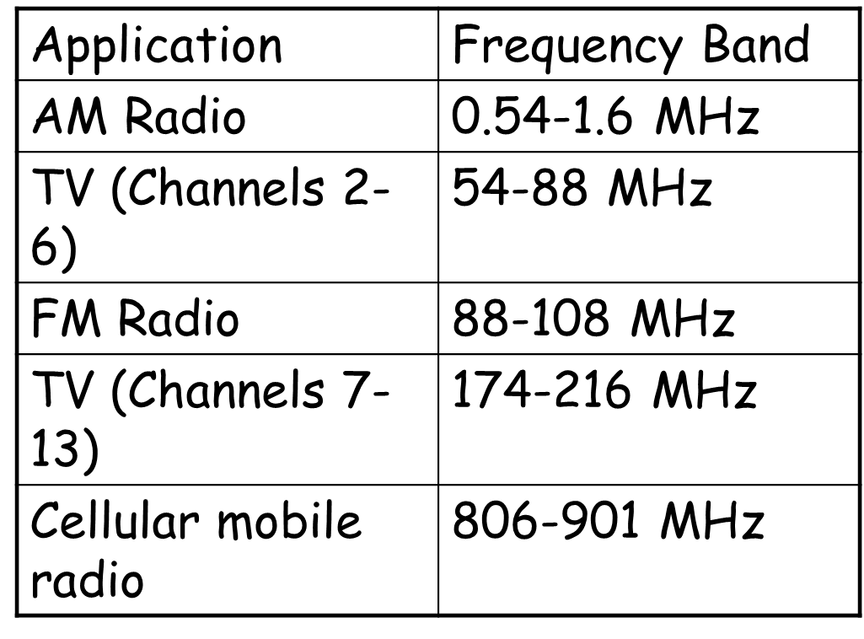
Bandwidths

